Slide 1
moledcule
your future friendly community based programmable led controller

Slide 2

moledcule
your future friendly community based programmable led controller

Slide 3

moledcule
welcome
We
introduction
In
background
Ba
sparky jr.
Sp
kaimana
Ka
opportunity
Op
moledcule
Mo
demo
De
compiler
Co
moledcule
your future friendly community based programmable led controller
thanks
Ta

Slide 4
moledcule
welcome
We
introduction
In
background
Ba
sparky jr.
Sp
kaimana
Ka
opportunity
Op
moledcule
Mo
demo
De
compiler
Co
moledcule
your future friendly community based programmable led controller
thanks
Ta

Slide 5
moledcule
welcome
We
introduction
In
background
Ba
sparky jr.
Sp
kaimana
Ka
opportunity
Op
moledcule
Mo
demo
De
compiler
Co
moledcule
your future friendly community based programmable led controller
thanks
Ta

Slide 6
moledcule
moledcule
welcome
We
introduction
In
welcome
your future friendly community based programmable led controller specifically design for the fighting game community, modders and fightstick enthusiasts.
control your LEDs (button, balltop, plate) right from molecule itself.
background
Ba
sparky jr.
Sp
kaimana
Ka
opportunity
Op
moledcule
Mo
demo
De
compiler
Co
moledcule
your future friendly community based programmable led controller
thanks
Ta

Slide 7
moledcule
welcome
We
introduction
hi, my name is eugene andruszczenko*
i am a full stack developer at
introduction
In
background
Ba
sparky jr.
Sp
kaimana
Ka
opportunity
Op
moledcule
Mo
demo
De
compiler
Co
thanks
Ta
* a.k.a 32teeth *true fact, google it

Slide 8
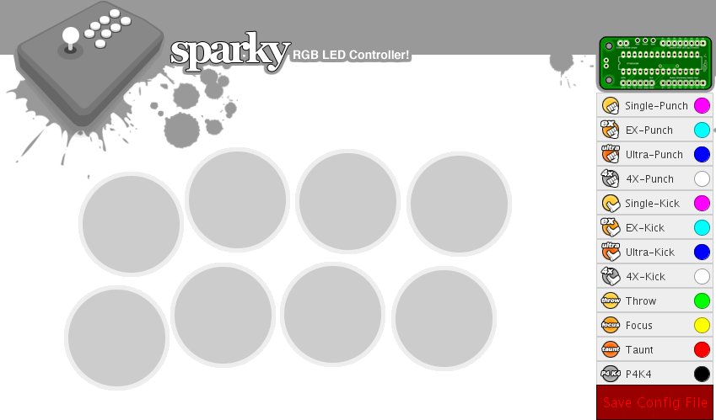
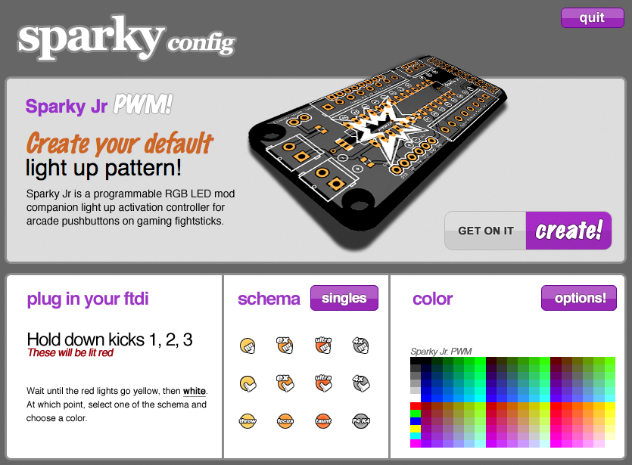
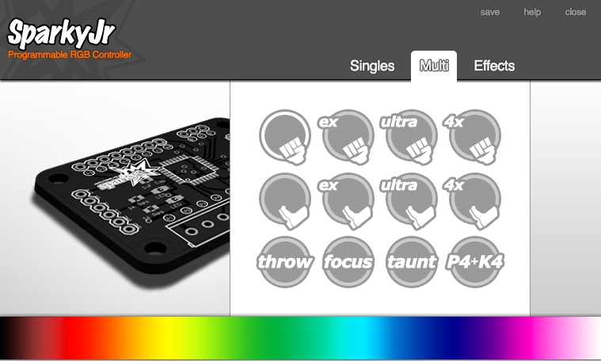
moledcule
welcome
We
introduction
i created the the original Sparky Jr RGB LED
ecosystem with the intent to enable users
with the hardware solution to drive their
arcade fightstick customization needs
introduction
In
background
Ba
sparky jr.
Sp
kaimana
Ka
opportunity
Op
moledcule
Mo
demo
De
compiler
Co
thanks
Ta

Slide 9
moledcule
welcome
We
introduction
i am here to talk about moledcule
moledcule was built to:
enable non technical users to leverage programmable RGB LEDs.
connect to your AVR microcontroller such as Arduino
compile and flash 'sketches' to the microcontroller
configure your devices
program without writing a line of code
introduction
In
background
Ba
sparky jr.
Sp
kaimana
Ka
opportunity
Op
moledcule
Mo
demo
De
compiler
Co
thanks
Ta

Slide 10
moledcule
welcome
We
background
this year (2016), i turned 40! and i had realized that i had been fortunate enough to be gainfully employed, in an industry sector i love, where hobby, became job, became career... ...for 21 years. that was more than half my life, doing what i love, and getting paid.
and then i got laid off.
as an active member of the FGC, OSH and OSS communities, and with much deserved rest and time on my hand, i started playing again, and reading the forums, and catching up on new hardware, but still i noticed that support for the third party hardware distributors was still a major headache. being one who does not sit idly by,
i decided that i can contribute to the community by giving back
introduction
In
background
Ba
sparky jr.
Sp
kaimana
Ka
opportunity
Op
moledcule
Mo
demo
De
compiler
Co
thanks
Ta

Slide 11
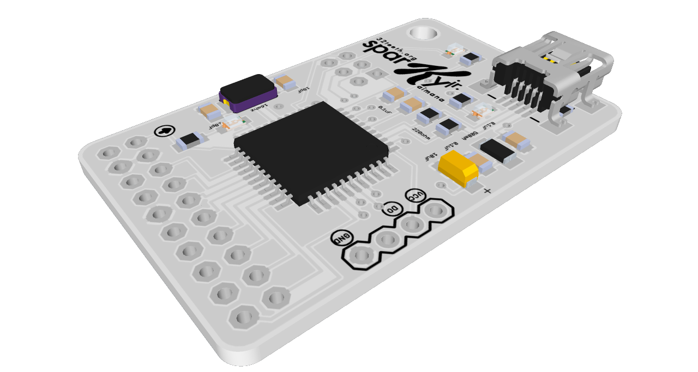
moledcule
welcome
We
Sparky Jr
a little over 8 year ago, Sparky Jr was unleashed on the FGC modding hubs
an AVR hardware based modular controller for RGB LED (both CA/CC)
saw 4 major releases
3 major arcade shop distribution
Introduced programmable hardware from Java app
configurator saw 4 major releases, and one Chrome App (still available)
helped and lead a standardized 20 pin breakout for all FGC based products
demonstrated at CreateInTO back in 2013!
FITC 2014!
introduction
In
background
Ba
sparky jr.
Sp
kaimana
Ka
opportunity
Op
moledcule
Mo
demo
De
compiler
Co
thanks
Ta

Slide 12

moledcule
welcome
We
kaimana
a 3rd party offshoot of Sparky Jr by
released 2014
two versions (mini and khaimana)
khaimana featured advanced soft switch between config and soft usb passthrough
introduction
In
background
Ba
sparky jr.
Sp
kaimana
Ka
opportunity
Op
moledcule
Mo
demo
De
compiler
Co
thanks
Ta

Slide 13


moledcule
welcome
We
opportunity
the kaimana modules became widely popular but:
user wanted customization
required install of Arduino IDE
not everyone is a C/C++ developer
growing community support (over 1000 post on one thread on SRK alone)
NONE OF THESE PROPLEMS WHERE MINE
Sparky Jr was
the intent was to build out a native solution that anyone can use
which actually became…
introduction
In
background
Ba
sparky jr.
Sp
kaimana
Ka
opportunity
Op
moledcule
Mo
demo
De
compiler
Co
thanks
Ta

Slide 14
moledcule
welcome
We
opportunity
solve the hardware issue using software create a community where users can:
create themes
manage themes
share themes
vote / rank themes
fork themes
clone themes
copy themes
think GitHub
flash / upload any public theme to their avr device
remove the IDE / download / C++ / avr toolchain barriers
by enabling a community to do all the above, gain trust, establish reputation, reputable software / configurator choice for 3rd party products
introduction
In
background
Ba
sparky jr.
Sp
kaimana
Ka
opportunity
Op
moledcule
Mo
demo
De
compiler
Co
thanks
Ta

Slide 15

moledcule
welcome
We
opportunity
the 7 layer bean dip mean stack
introduction
In
background
Ba
sparky jr.
Sp
kaimana
Ka
mongo
express
angular
node
avrgirl
codebender
amazon
opportunity
Op
moledcule
Mo
demo
De
compiler
Co
thanks
Ta

Slide 16
moledcule
welcome
We
opportunity
the 7 layer bean dip mean stack
introduction
In
background
Ba
sparky jr.
Sp
kaimana
Ka
mongo
express
angular
node
avrgirl
codebender
amazon
storage for users, profiles, themes
web app framework, middleware everything
well, you know, it’s not MERN
runtime ftw
AVR JavaScript helpers
Compiler as a Service
Where else you gonna put it
opportunity
Op
moledcule
Mo
demo
De
compiler
Co
thanks
Ta

Slide 17
moledcule
welcome
We
opportunity
the 7 layer bean dip mean stack
introduction
In
background
Ba
sparky jr.
Sp
kaimana
Ka
mongo
express
angular
node
avrgirl
codebender
amazon
opportunity
Op
moledcule
Mo
demo
De
compiler
Co
thanks
Ta

Slide 18
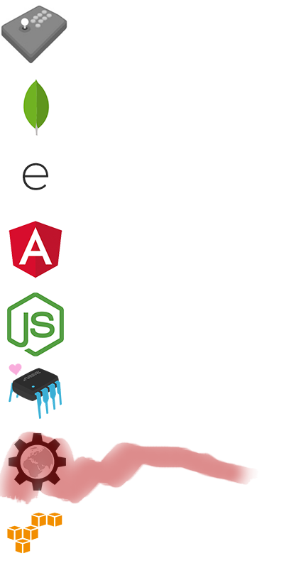
moledcule
welcome
We
opportunity
the 6 layer bean dip mean stack
introduction
In
background
Ba
sparky jr.
Sp
kaimana
Ka
mongo
express
angular
node
avrgirl
codebender
amazon
opportunity
Op
moledcule
Mo
demo
De
compiler
Co
thanks
Ta

Slide 19
moledcule
welcome
We
opportunity
the 6 layer mean stack
introduction
In
background
Ba
sparky jr.
Sp
kaimana
Ka
mongo
express
angular
node
avrgirl
codebender
amazon
whatever, I’ll build my own
opportunity
Op
moledcule
Mo
demo
De
compiler
Co
thanks
Ta

Slide 20
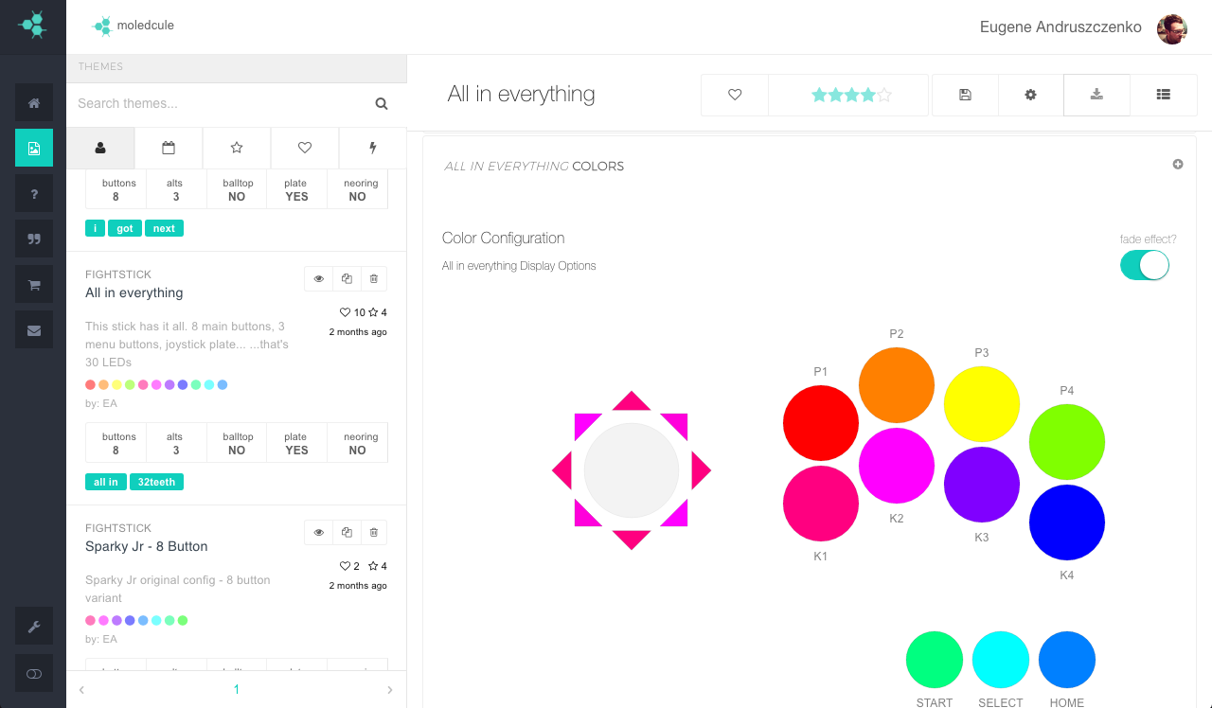
moledcule
welcome
We
moledcule
your future friendly community based programmable led controller specifically design for the fighting game community, modders and fightstick enthusiasts. control your LEDs (button, balltop, plate) right from molecule itself.
introduction
In
background
Ba
sparky jr.
Sp
kaimana
Ka
opportunity
Op
moledcule
Mo
demo
De
compiler
Co
thanks
Ta

Slide 21
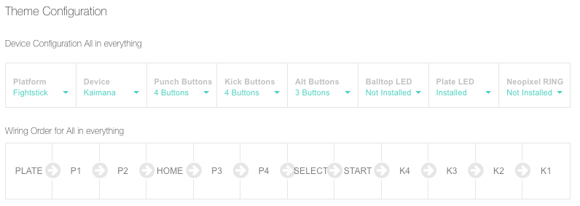
moledcule
welcome
We
moledcule
solving one problem at a time the biggest gripe users had with their hardware was wiring order usually didn’t vibe with default provided by
kaimana hardware
moledcule solved this by introducing a unique drag an drop wire order systems
introduction
In
background
Ba
sparky jr.
Sp
kaimana
Ka
opportunity
Op
moledcule
Mo
demo
De
compiler
Co
thanks
Ta

Slide 22
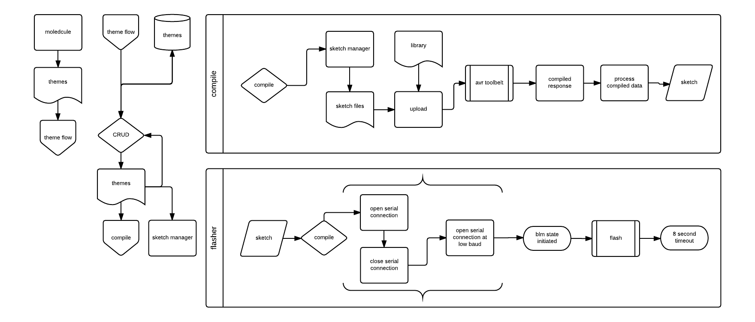
moledcule
welcome
We
moledcule
application flow
introduction
In
background
Ba
sparky jr.
Sp
kaimana
Ka
opportunity
Op
moledcule
Mo
demo
De
compiler
Co
thanks
Ta

Slide 23
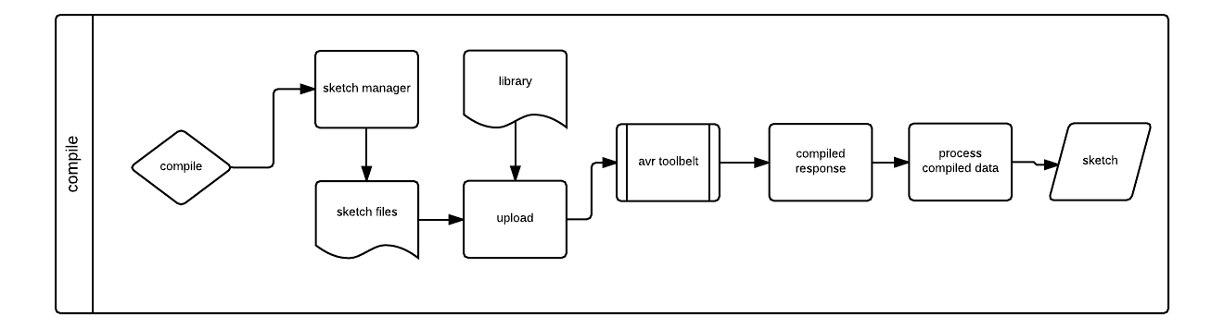
moledcule
welcome
We
moledcule
compilier as a service
an exclusively unique feature of the moledcule ecosystem, was the introduction of a compiler as a service (CompaaS), code named ‘richard’!
’richard’ is simply a federated avr toolbelt and build system, think avrdude in the cloud.
introduction
In
background
Ba
sparky jr.
Sp
kaimana
Ka
opportunity
Op
moledcule
Mo
demo
De
compiler
Co
thanks
Ta

Slide 24
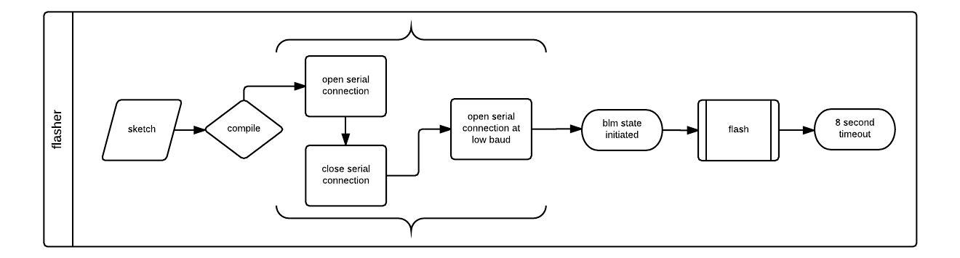
moledcule
welcome
We
moledcule
flasher
in previous iterations (Sparky Jr), the installed firmware contained extensive serial commands for on chip programming. moledcule removed this dependency, and freed up close to 6,000 bytes of program space and 800 bytes of dynamic memory… …this was huge! meet ‘genya’
with ‘genya’ we can overwrite the existing sketch, with the newly compiled one ‘richard’ provided us with. HUGE!
introduction
In
background
Ba
sparky jr.
Sp
kaimana
Ka
opportunity
Op
moledcule
Mo
demo
De
compiler
Co
thanks
Ta

Slide 25
moledcule
welcome
We
demo
a simple presentation of
theme creation
theme color selection
wire management
introduction
In
background
Ba
sparky jr.
Sp
kaimana
Ka
opportunity
Op
moledcule
Mo
demo
De
compiler
Co
thanks
Ta

Slide 26
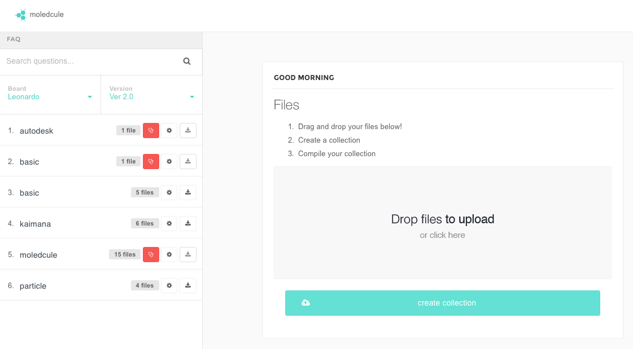
moledcule
welcome
We
demo
a simple presentation of
drag and drop
error messaging
download capabilities
introduction
In
background
Ba
sparky jr.
Sp
kaimana
Ka
opportunity
Op
moledcule
Mo
demo
De
compiler
Co
thanks
Ta

Slide 27
bonus round
moledcule
your future friendly community based programmable led controller

Slide 28
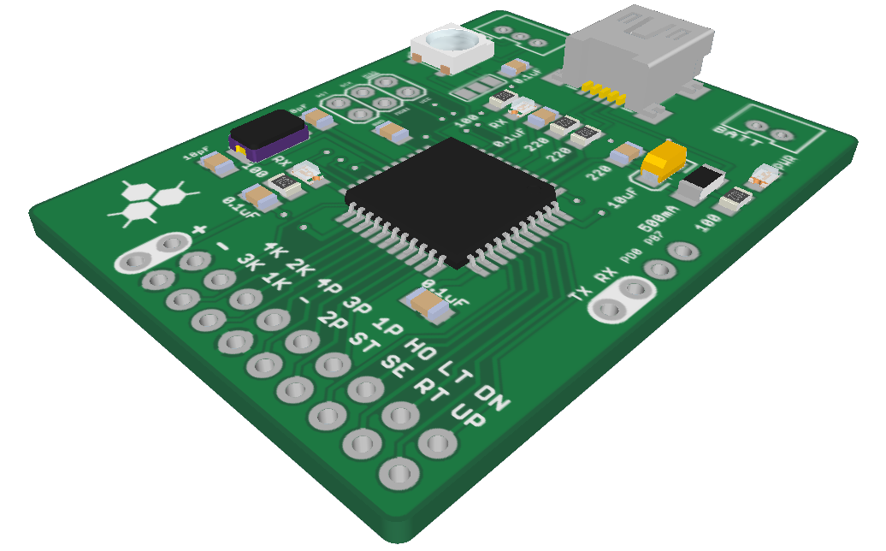
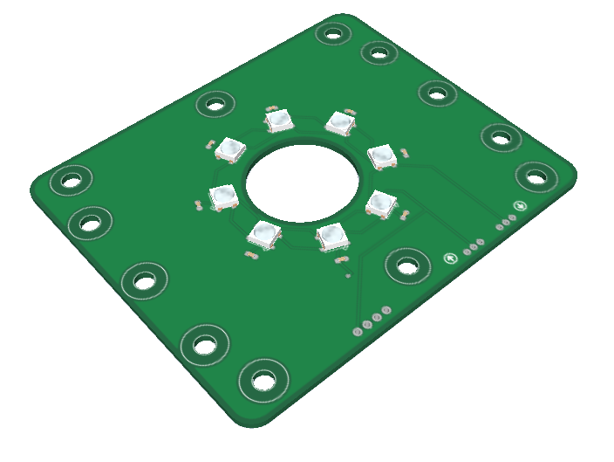
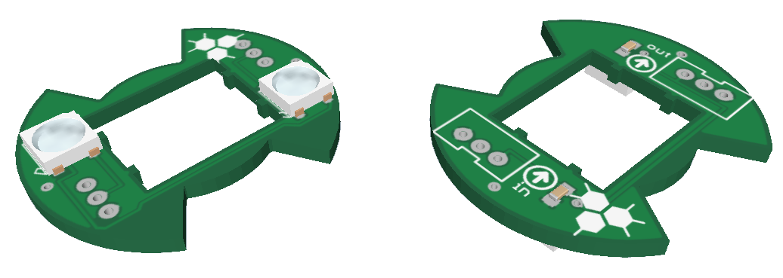
moledcule
welcome
We
welcome
your future friendly community based programmable led controller specifically design for the fighting game community, modders and fightstick enthusiasts. control your LEDs (button, balltop, plate) right from molecule itself.
introduction
In
background
Ba
sparky jr.
Sp
kaimana
Ka
opportunity
Op
moledcule
Mo
demo
De
compiler
Co
thanks
Ta

